Slide 1
Logistics Dashboard Insights
Key Findings & Recommendations
PRESENTED BY AKILA HM

Slide 2
Introduction
Objective: Provide leadership with a clear view of logistics performance through key visual insights. Key Focus Areas:
Shipment Performance (On-Time vs. Late)
Cost Efficiency (Freight & Product Cost)
Delivery Trends & Transit Times
Forwarder Performance

Slide 3
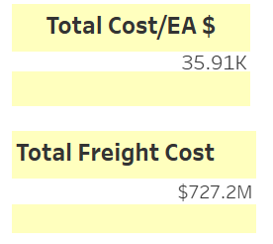
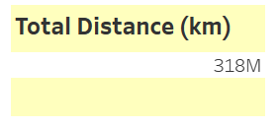
Understanding the Pharma Logistics
Total Cost/ EA in $ is 35.91K
Total Freight Cost in $ is 727 M
Total Distance in Km is 318 M
3 Types of Transportation ( Air, Ocean, Truck)
8230 Unique Products are Presented
Normal and Express Service are available
Delivery are mostly done On – Time
17 Forwarders for Transportation
Totally 3 Years are mentioned (2020,2021,2022)

Slide 4
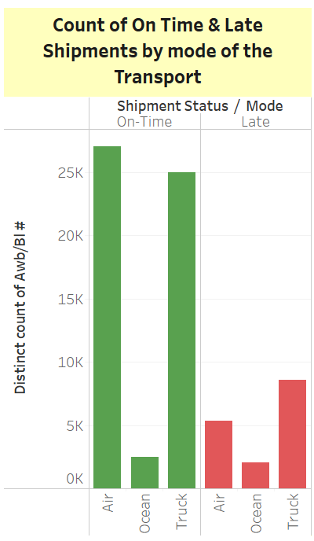
Shipment Performance Overview Key Finding 1 : Count of On Time & Late Shipments by mode of the Transport
Count of On- Time Shipment:
Air : 27,043
Ocean : 2,514
Truck : 24,975
Count of Late Shipment Rate:
Air : 5,354
Ocean : 2,058
Truck : 8,605

Slide 5
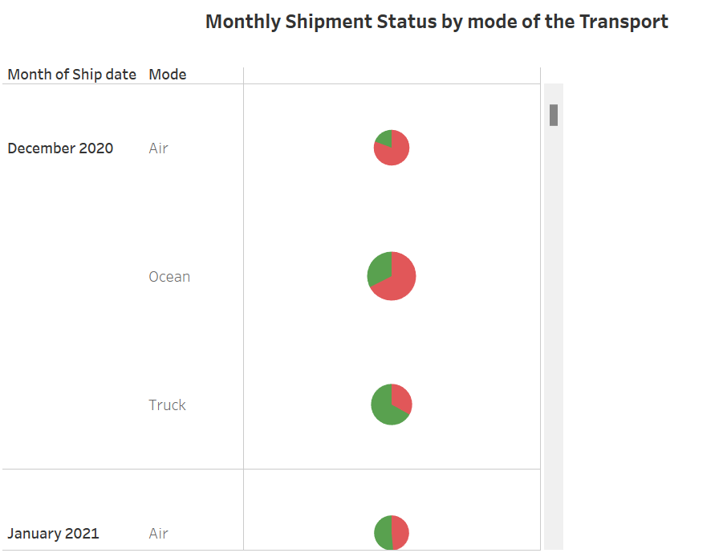
Key Finding 2 : Monthly Shipment Status by mode of the Transport
Among all mode of the transport Air was able to deliver the products On – Time across the year and months.
Ocean has mostly Late Shipment Status in March 2021, January 2021,March 2022. April 2021, February 2021,October 2021 , December 2021, August 2022, February 2022, April 2022, December 2020, November 2021.
Truck plays a mid role Shipment Status across the months and years

Slide 6
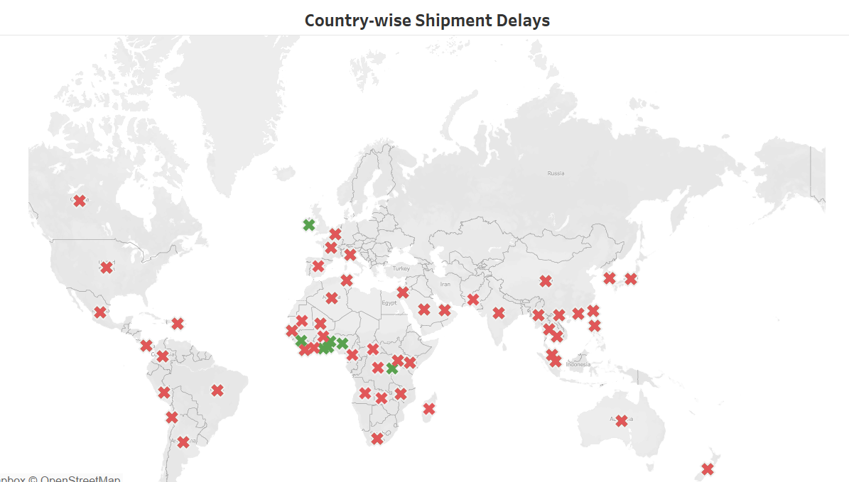
Key Finding 3 : Country wise Shipment Delays
Most On- Time Shipments in the Destination Countries are :
BY
CY
KW
MO
LA
SL
TG
GA
CG
RW
BI
TZ

Slide 7
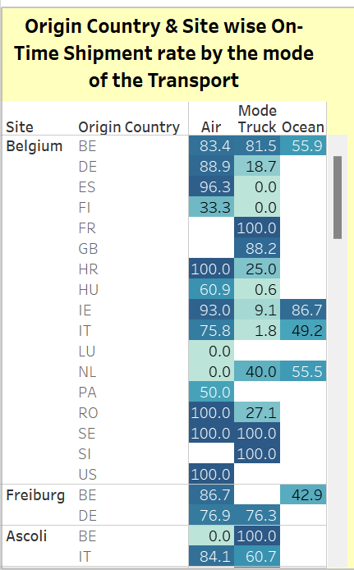
Key Finding 4 : Origin Country & Site wise On- Time Shipment rate by the mode of the transport
Air has the highest On – Time Shipment Rate among the Site and the Origin Country.
Truck has the second highest On- Time Shipment Rate.
Ocean has the highest On – Time Shipment Rate only in the countries of BE and TW

Slide 8
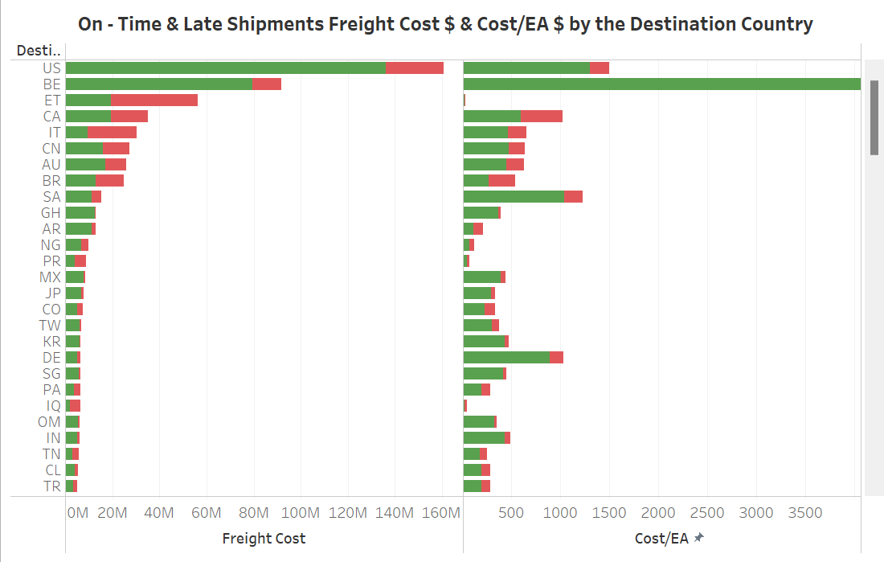
Cost Analysis & Optimization Key Finding 1 : On- Time & Late Shipments Freight Cost $ & Cost/EA $ by the Destination Country
Top 3 Destination Countries which has On-Time Shipment Highest Freight Cost $ :
US : 136.11M
BE : 79.42M
ET : 19.50 M
Top 3 Destination Countries which has On-Time Shipment Highest Cost/EA $ :
BE : 7,633
US : 1,304
SA : 1,046

Slide 9
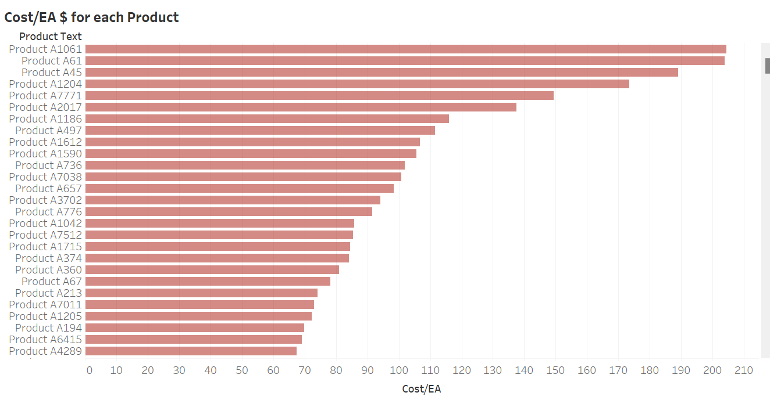
Key Finding 2 : Cost/EA $ for each product
Top 3 Product which has highest Cost/EA $:
Product A1061 : 204.4
Product A61 : 203.8
Product A45 : 189
Least 3 Product which has lowest Cost/EA $ :
Product A5424, A4259, A2348 : 0.001
Product A7374, A8162, A4663, A2668 : 0.002
Product A8037, A5784, A4262, A7557, A6915 : 0.003

Slide 10
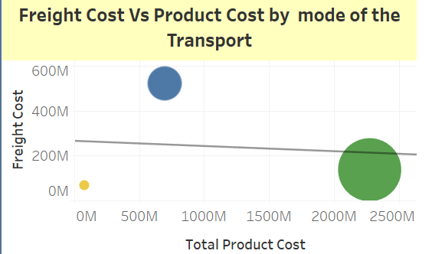
Key Finding 3 : Freight Cost Vs Product Cost by mode of the Transport
Mode : Truck
Total Freight Cost $ : 137.11M
Total Product Cost $ : 2.28 B
Quantity in Sales (EA) : 5.67 B
Mode : Air
Total Freight Cost $ : 520.58 M
Total Product Cost $ : 0.70 B
Quantity in Sales (EA) : 1.66 B
Mode : Ocean
Total Freight Cost $ : 69.53 M
Total Product Cost $ : 0.08 B
Quantity in Sales (EA) : 1.14 B

Slide 11
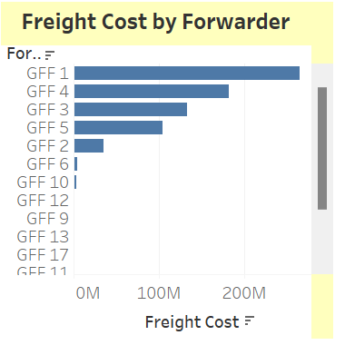
Key Finding 4 : Freight Cost $ by Forwarder
Top 3 Forwarder who cost highest Freight Cost $:
GFF 1 : 264.30 M
GFF 4 : 181.43 M
GFF 3 : 132.86 M
Top 3 Forwarder who cost lowest Freight Cost $:
GFF 8, GFF 15 : 0.00 M
GFF 16 : 0.001 M
GFF 14 : 0.003 M

Slide 12
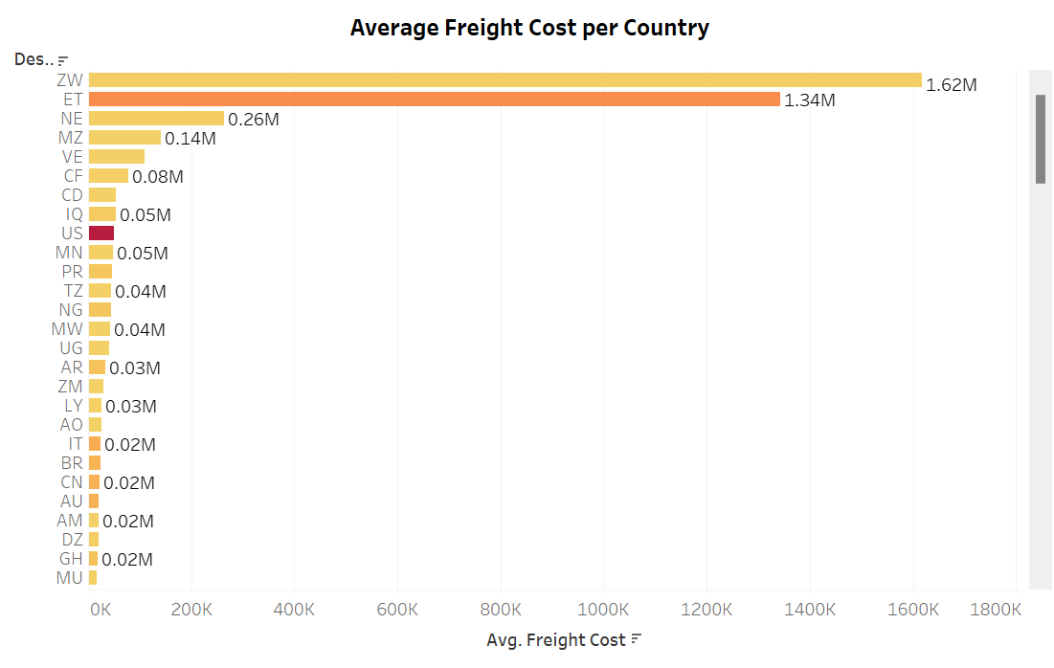
Key Finding 5 : Average Freight Cost $ per Country
Top 3 Destination Countries which has highest Average Freight Cost $:
ZW : 1.62 M
ET : 1.34 M
NE : 0.26 M

Slide 13
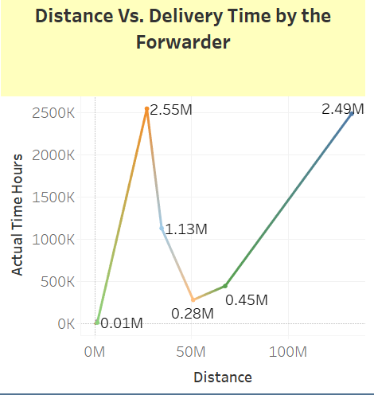
Delivery Efficiency & Transit Time Key Finding 1 : Distance Vs Delivery Time by the Forwarder
GFF 3 has the highest Delivery Time hours of 2.55 M and covered Distance (km) of 26.95 M
Secondly, GFF 1 has Delivery Time hours of 2.59 M and covered Distance (km) of 132.75 M
Thirdly , GFF 2 has Delivery Time hours of 1.13 M and covered Distance (km) of 34.56 M

Slide 14
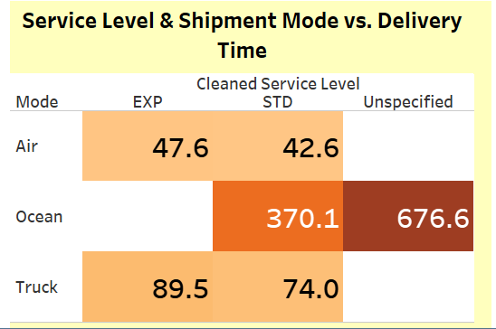
Key Finding 2 : Service Level & Shipment Mode Vs. Delivery Time
Express Service Level has highest Delivery time hours of 89.5 on the mode of Truck.
Standard Service Level has highest Delivery time hours of 370.1 on the mode of Ocean.
There are Unspecified Delivery Time hours of 676.6 on the mode of Ocean

Slide 15
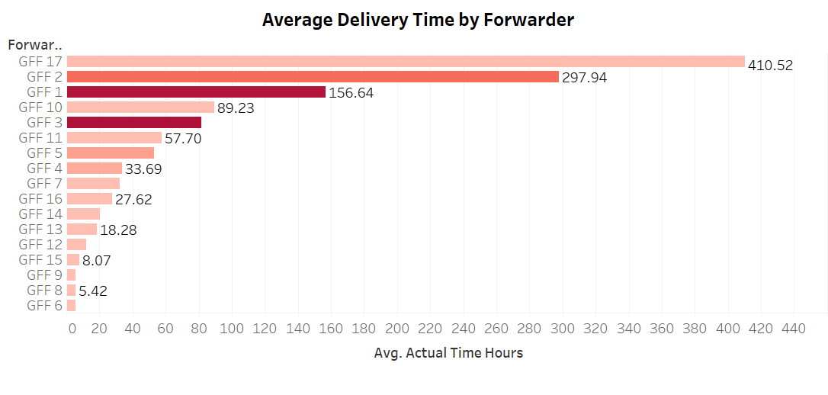
Key Finding 3 : Average Delivery Time by Forwarder
Top 3 Forwarders who has highest Average Delivery Time hours :
GFF 17 : 410.52
GFF 2 : 297.94
GFF 1 : 156.64
Top 3 Forwarders who has lowest Average Delivery Time hours :
GFF 6 : 5.36
GFF 8 : 5.42
GFF 9 : 5.46

Slide 16
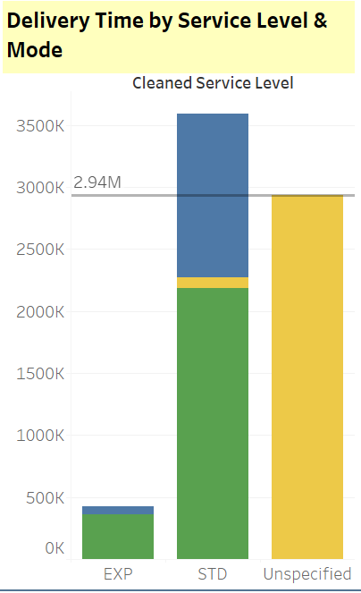
Key Finding 4 : Delivery Time by Service Level & Mode of the transport
Express Service Level has Delivery time hours of 0.36 M on Truck and 0.07 M on Air
Standard Service Level has Delivery time hours of 2.19 M on Truck , 1.32 M on Air and 0.09 M on Ocean.
There are 2.94 M Unspecified Service Level on Ocean.
Overall Median = 2.94 M

Slide 17
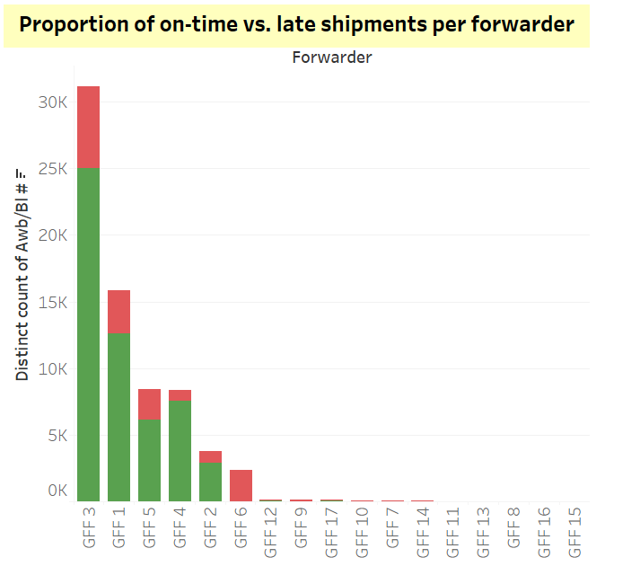
Forwarder Performance Analysis Key Finding 1 : Proportion count of On-Time vs Late shipments per forwarder
Top 3 Forwarders who has highest Count of On-Time shipments :
GFF 3 : 24,999
GFF 1 : 12,622
GFF 5 : 6,116

Slide 18
Actionable Recommendations:
Identify regions with consistent delays and optimize scheduling.
Work with forwarders to improve transit efficiency.
Optimize freight strategy by selecting cost-effective forwarders.
Consider alternative shipping modes for high-cost products.
Streamline delivery routes & optimize service level selection.
Use predictive analytics to estimate and reduce delays.
Renegotiate contracts with underperforming forwarders.
Increase shipments with efficient forwarders for better results.
Reduce freight cost inefficiencies by optimizing forwarder selection.
Improve shipment planning in high-delay regions.
Enhance service level selection based on urgency & cost efficiency.

Slide 19
Thank You

